Slide 1
Drone Phenology Monitoring
Gaurav Rajput
Parth Thakur

Slide 2
Additional Params for Matching
We see wrong matches in crowded regions. Use weighted combination of geometric and spatial features
spatial_sim = max(0, 1 - (centroid_dist / max_dist))
area_sim = min(area1, area2) / max(area1, area2)
Compactness: (4 * π * area) / (perimeter^2) (how circular the shape is).
Eccentricity: Ratio of minor to major axis of the minimum bounding rectangle.
shape_sim = (compactness_sim + eccentricity_sim) / 2

Slide 3
Matching Statistics
- **Total Trees Detected**: 626
- **Total Tracking Edges**: 476
- **Average Chain Length**: 4.17
- **Maximum Chain Length**: 5
## Chain Length Distribution
- **Length 2**: 20 trees
- **Length 3**: 14 trees
- **Length 4**: 36 trees
- **Length 5**: 80 trees

Slide 4
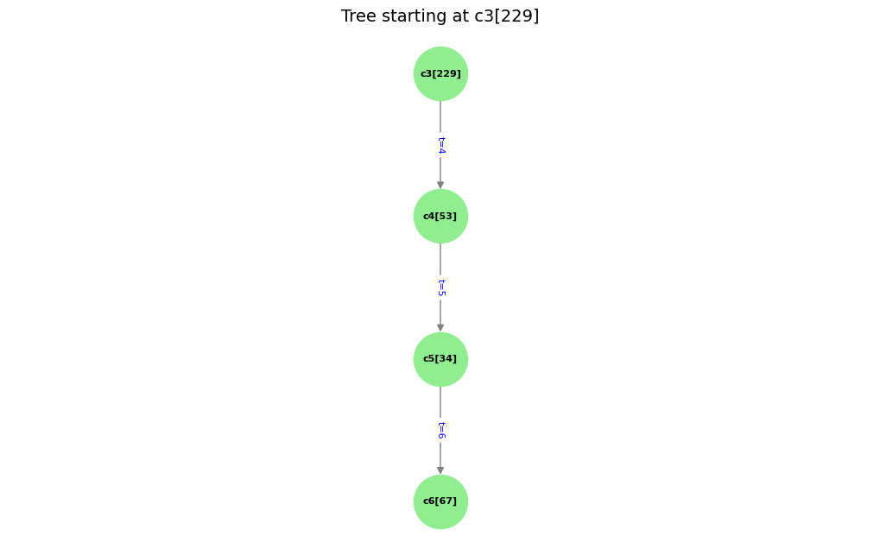
t | Date | Time
3 | 26/04/2025 | 12–1 pm
4 | 16/06/2025 | 1–2 pm
5 | 29/06/2025 | 1–2 pm
6 | 12/07/2025 | 12–1 pm

Slide 5
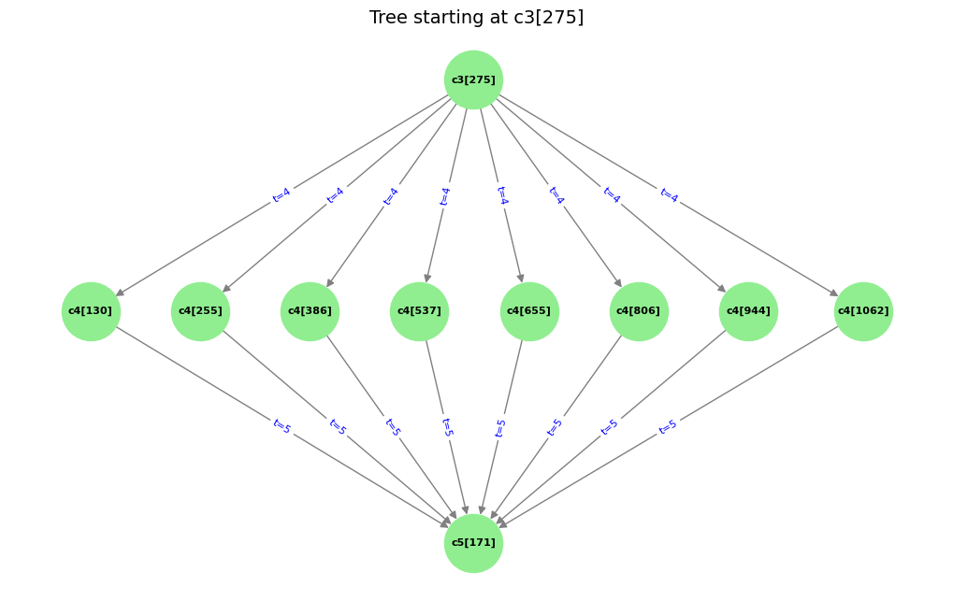
t | Date | Time
3 | 26/04/2025 | 12–1 pm
4 | 16/06/2025 | 1–2 pm
5 | 29/06/2025 | 1–2 pm
6 | 12/07/2025 | 12–1 pm

Slide 6
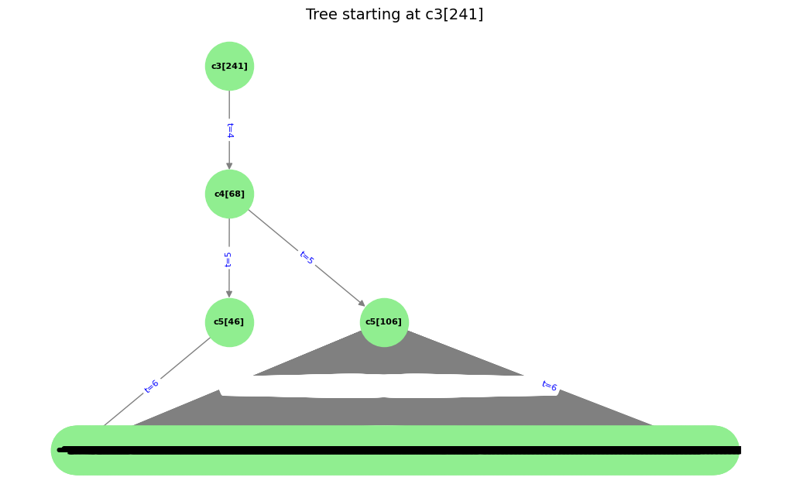
Here the issue is we are getting too many c6 because IOU threshold being set too low, therefore we came up with the idea of not only relying completely on IOU, instead rely on similarity Score
t | Date | Time
3 | 26/04/2025 | 12–1 pm
4 | 16/06/2025 | 1–2 pm
5 | 29/06/2025 | 1–2 pm
6 | 12/07/2025 | 12–1 pm

Slide 7

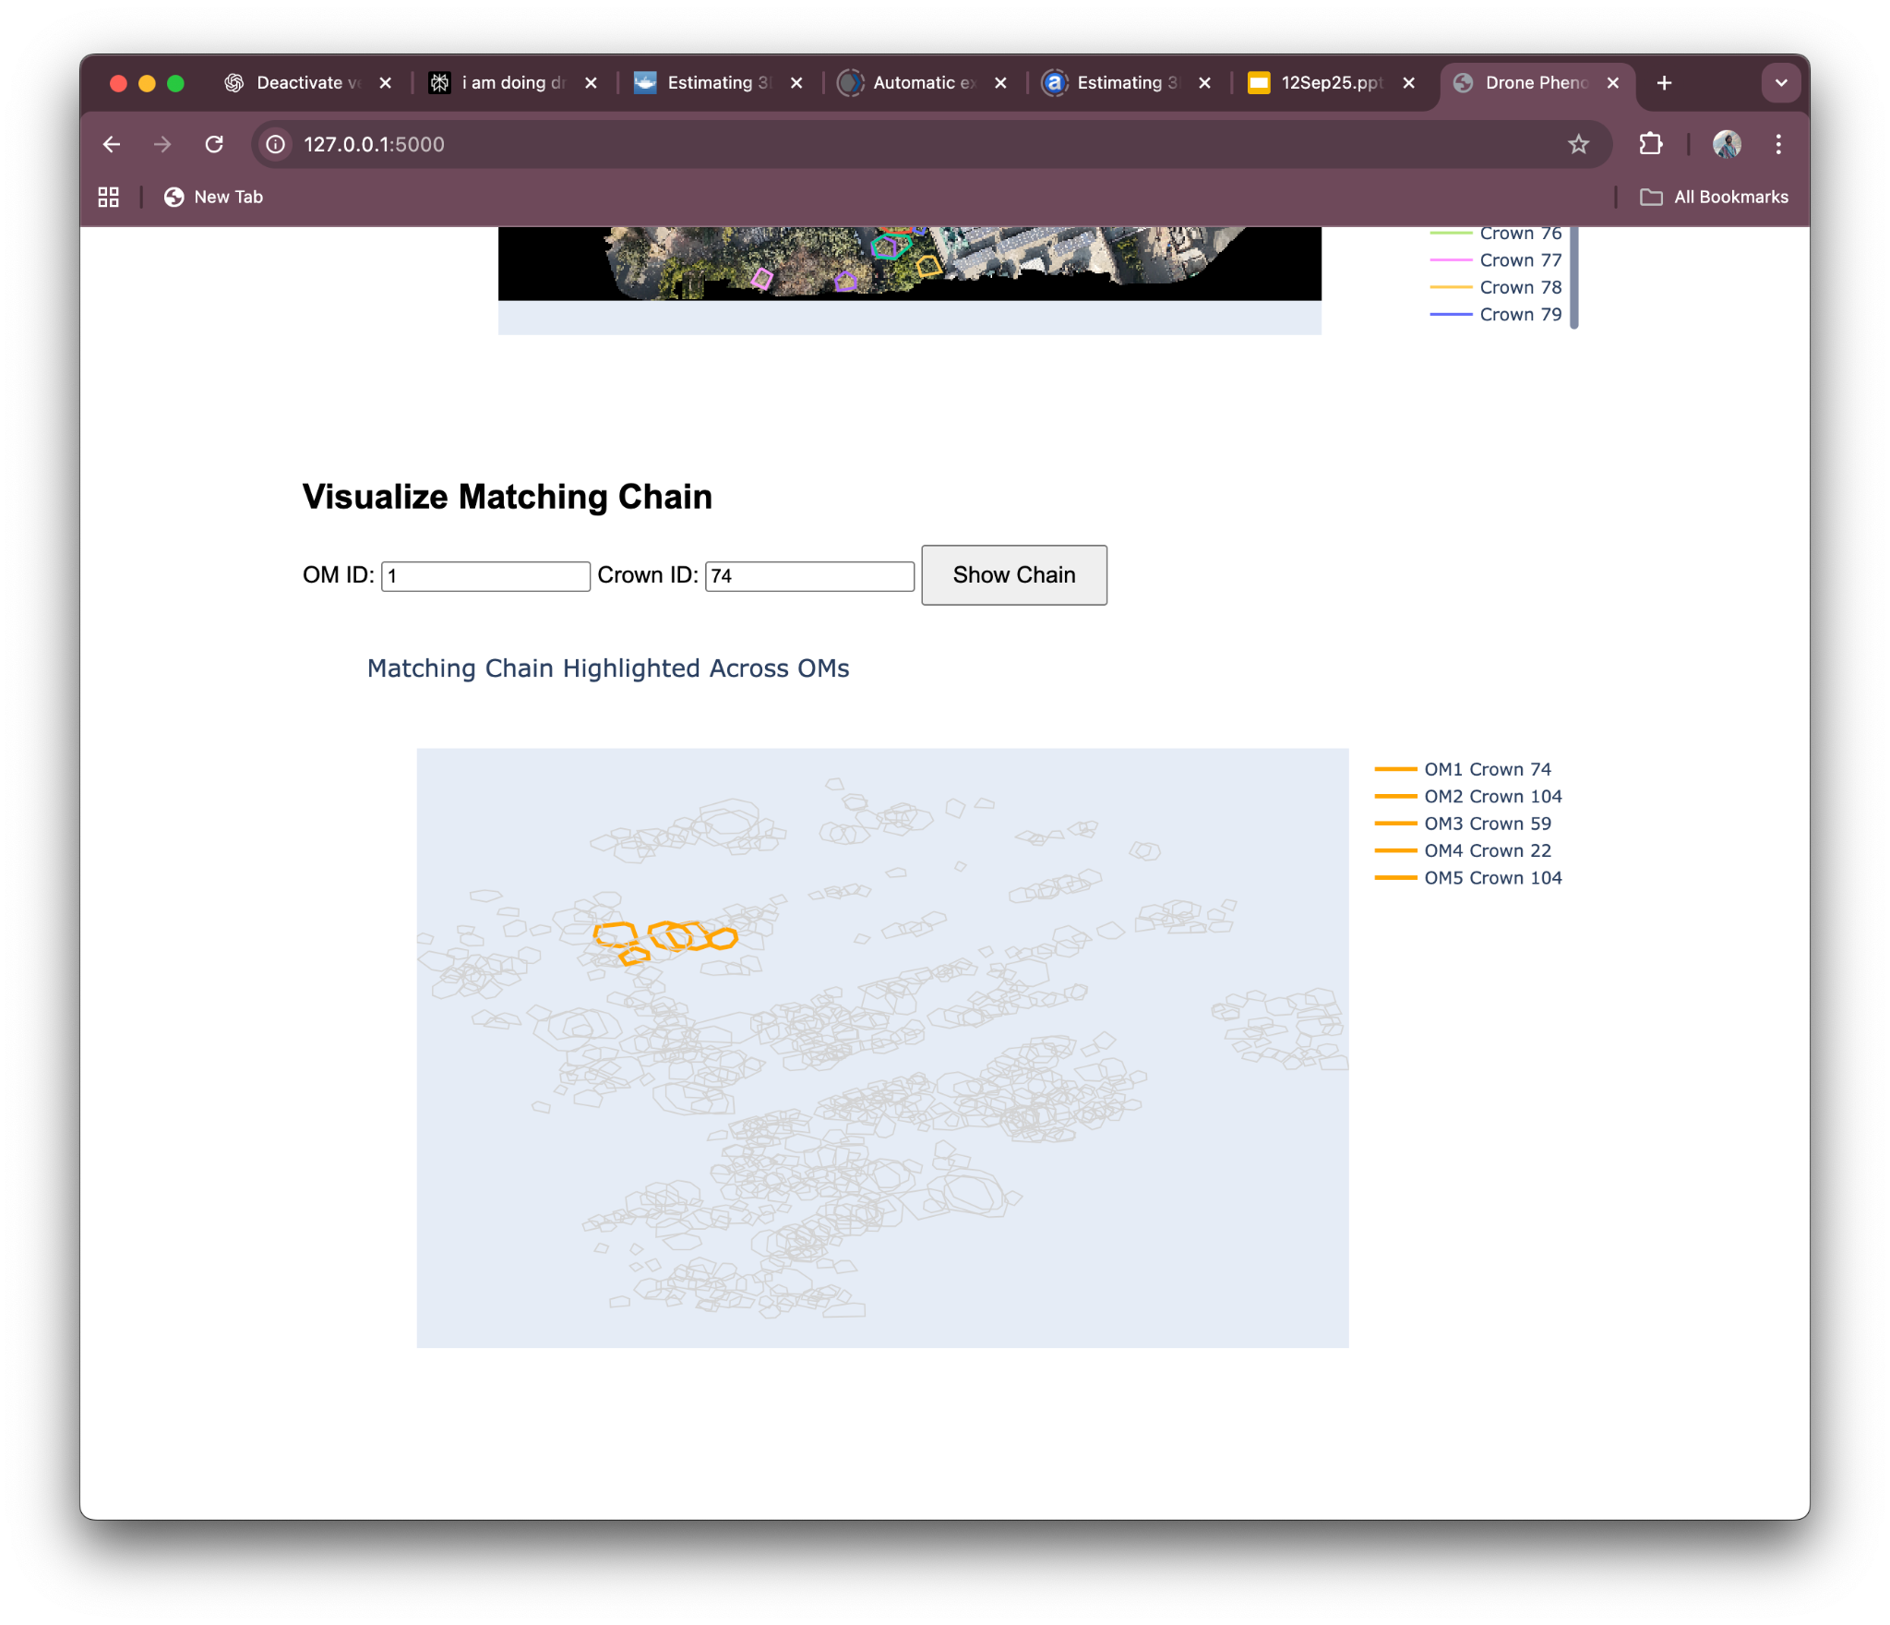
Web App for tracking Visualisation

